Slide 1



Tying everything together - the three tier architecture
Lecture 10
Joe Appleton
CSEE

Slide 2
Last Week WE
Considered the role of a web framework in the development of a web application
Considered the role of a web server in the development of a web application
Used the Express framework to create a web application
Use middleware in a web application
Understand how to use `ejs` templates to create dynamic web pages.
Used `npm` to manage all of this.
Notes:
Develop students' understanding of the theory, design, and development of database systems and the key role database systems play in the real world
Equip students with the basic knowledge of frontend and backend web technologies that can be used to interface a database system
Develop students' analytical and problem-solving skills via modelling data of real-world problems
Perspective of the designer and developer of db systems

Slide 3
A CODE Recap
Notes:
“Learn about the key technologies of Database systems and the World Wide Web (WWW)”. Why is the important?
Databases are the core component of most computer application.

Slide 4
This Week
This week, we will conclude the web part of the module.
Specifically, we will consider:
How to Create a full-stack web application using Node.js, Express, and MySQL.
The various compliance issues and best practices surrounding the development of web applications.
How to implement simple data validation on the server and client side.
Understand the three tier architecture.
Notes:
We will be learning about the Node Package Manager (npm)

Slide 5
By the end of the week
You’ll be able to complete all the assessment tasks!
Notes:
We will be learning about the Node Package Manager (npm)

Slide 6
The Three Tier Architecture
Notes:
“Learn about the key technologies of Database systems and the World Wide Web (WWW)”. Why is the important?
Databases are the core component of most computer application.

Slide 7
What is a three tier Architecture?
The three-tier architecture is a common architecture for web applications. It is a client-server architecture that separates the presentation layer, the application layer and the data layer.
Improved scalability and maintainability.
Clear separation of concerns
Presentation Tier
HTML/EJS
Logic Tier
Node.JS
Data Tier
MySQL

Slide 8
The Presentation Layer (Client)
is the layer that the user interacts with.
responsible for rendering the user interface and handling user input.
typically implemented using HTML, CSS and JavaScript.
can create sophisticated
web Browsers: Browsers like Chrome, Firefox, and Safari are examples of clients that render and display web applications.
mobile apps running on devices such as smartphones or tablets also serve as clients interacting with the presentation layer.

Slide 9
Application Layer (Server)
Business logic and application processing
authentication,
data validation
business rules
Communication between presentation and data layers.
Examples: Node.js, Django, Flask.

Slide 10
Data Layer (Database)
manages the storage of structured data in a database system.
ensures efficient and secure access to stored information.
handle tasks such as data organization, indexing, and ensuring data integrity.
examples: MySQL, PostgreSQL, MongoDB.

Slide 11
Possible Drawbacks of a 3-Tier Architecture
Single point of failure.
The communication between layers involves passing data back and forth. This can lead to increased overhead, especially if not managed efficiently.
Developing a three-tier architecture can sometimes take more time compared to a simple HTML/CSS application.
Changes in one layer may require corresponding adjustments in other layers

Slide 12
Wider Architectures
Microservices Architecture:
Serverless Architecture

Slide 13
Storing User Data
Notes:
“Learn about the key technologies of Database systems and the World Wide Web (WWW)”. Why is the important?
Databases are the core component of most computer application.

Slide 14
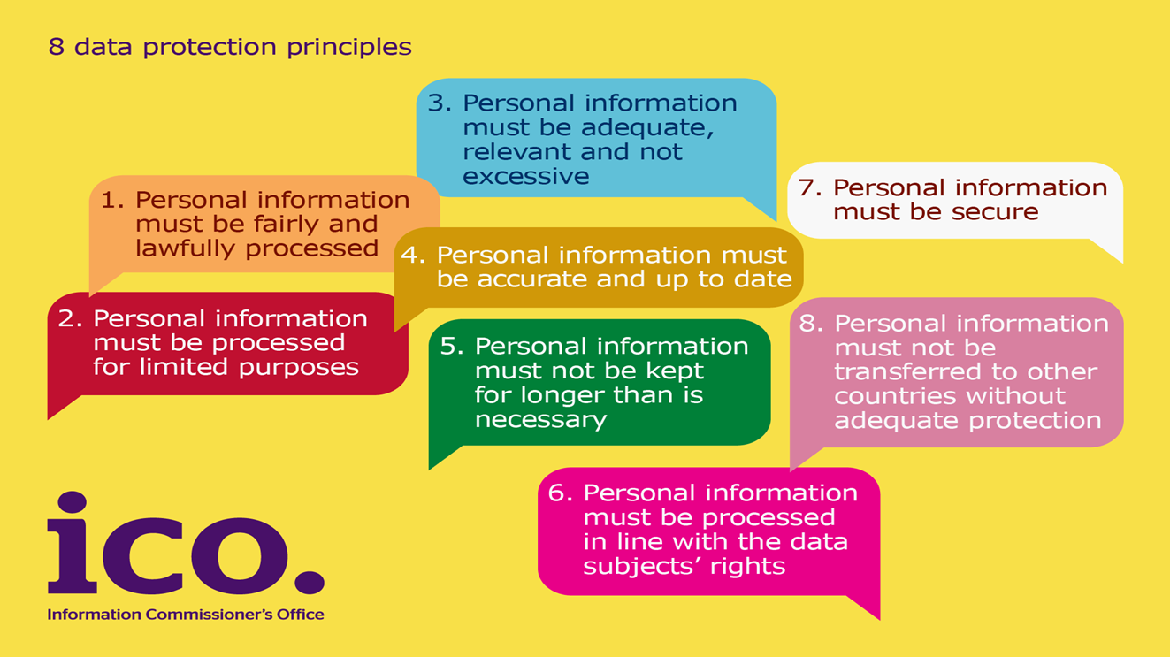
Data Protection Act 1998 The eight principles
Notes:
The Data Protection Act 1998 has eight principles.
Principle One: Personal Information must be fairly and lawfully processed
Principle Two: Personal Information must be processed for limited purposes
Principle Three: Personal Information must be adequate, relevant and not excessive
Principle Four: Personal Information must be accurate and up to date
Principle Five: Personal Information must not be kept for longer than is necessary
Principle Six: Personal Information must be processed in line with data subjects’ rights
Principle Seven: Personal data must be secure
Principle Eight: Personal Information must not be transferred to other countries without adequate protection

Slide 15


I British Pregnancy Advice Service
Date: 7 March 2014
British Pregnancy Advice Service fined £200,000. Hacker threatened to publish thousands of names of people who sought advice on abortion, pregnancy and contraception.
Abortion provider BPAS fined £200,000 for data breach
Notes:
We would like to draw your attention to a particular case where the ICO issued a Civil Monetary Penalty, and the risks of poor information security controls were highlighted.
This breach occurred in March 2012 when the website of the British Pregnancy Advisory Service (or BPAS) was attacked. The attacker used an automated tool to identify website vulnerabilities. These tools are widely available on the internet and target well known vulnerabilities and poor website coding practices.
BPAS’ website enabled users to request a call back for advice by completing a web form with contact details. Unknown to BPAS, the website retained a copy of the call-back details unnecessarily and this was available to the attacker after he gained access to the website’s content management system. Fortunately the attacker was not able to publish this information which was recovered by police.
BPAS have now removed the call-back details from the website and taken substantial remedial action to ensure that this security breach will not be repeated.
This incident was deemed to be a breach of the 7th Principle. In particular BPAS failed to take appropriate technical and organisational measures against the unauthorised processing of personal data stored on their website. In addition, the breach was of a kind likely to cause substantial damage or substantial distress. Users of the website could have been caused distress simply by knowing that their personal data had been accessed by the attacker, and by the concern that the data may have been further disclosed.
How would you feel if this was your data?
How would you feel if you had been responsible for the breach?
How would this affect your organisation?
How would this affect your clients or service users?

Slide 16
The General Data Protection Regulation (GDPR)

